Slide 1
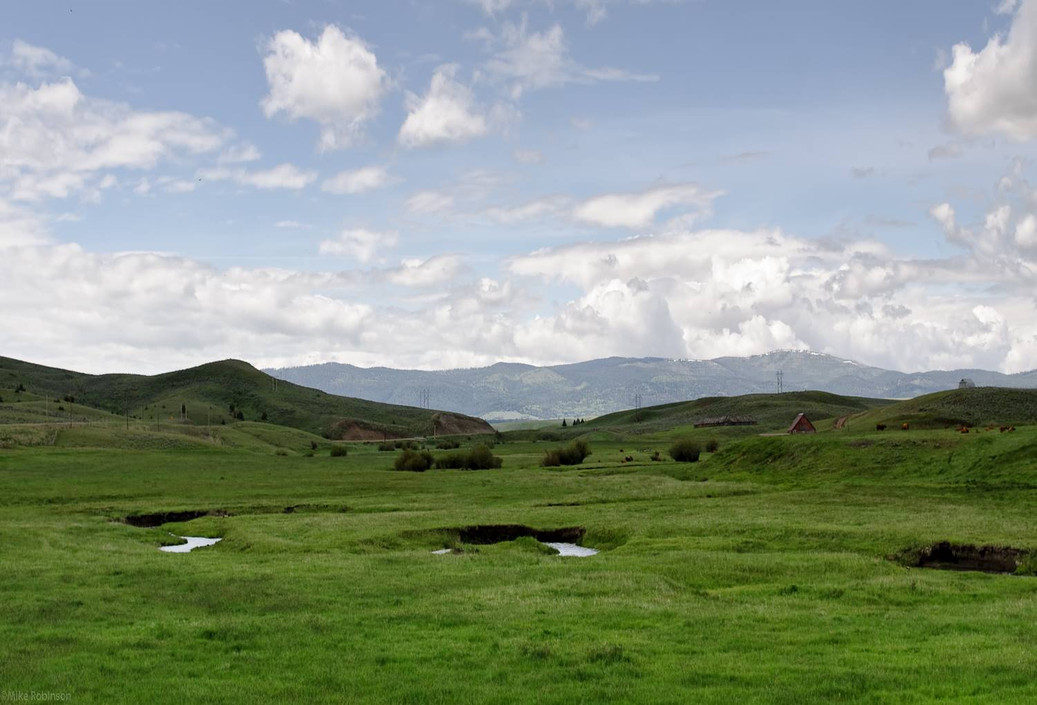
Welcome
to First Christian Church
Reaching Outward to Connect
People with God's Abundance
Notes:
Layout: Worship Title
Title: Level 1
Blank Line: Level 3
Name: Level 2
Use “indent” function (alt+shft+arrows) to change text style (level 1,2,3 etc).
Reset Slide will reset all styles to match the slide master.
To change Slide Background, Image, Text Box size etc, go to View – Slide Master View, and make changes there. Those changes will then be uniformly made throughout the Slideshow.

Slide 2
Gift of Finest Wheat - Charles Callahan
Notes:
Layout: Worship Title
Title: Level 1
Blank Line: Level 3
Name: Level 2
Use “indent” function (alt+shft+arrows) to change text style (level 1,2,3 etc).
Reset Slide will reset all styles to match the slide master.
To change Slide Background, Image, Text Box size etc, go to View – Slide Master View, and make changes there. Those changes will then be uniformly made throughout the Slideshow.

Slide 3
Welcome
to First Christian Church
Reaching Outward to Connect
People with God's Abundance
Notes:
Layout: Worship Title
Title: Level 1
Blank Line: Level 3
Name: Level 2
Use “indent” function (alt+shft+arrows) to change text style (level 1,2,3 etc).
Reset Slide will reset all styles to match the slide master.
To change Slide Background, Image, Text Box size etc, go to View – Slide Master View, and make changes there. Those changes will then be uniformly made throughout the Slideshow.

Slide 4
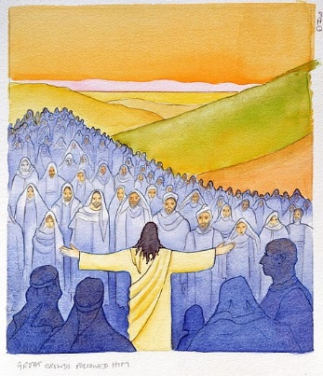
Call to Worship
Worship
Elder:
Gary Ochs
Notes:
Layout: Worship Title
All = Level 1
Use “indent” function (alt+shft+arrows) to change text style (level 1,2,3 etc).
Reset Slide will reset all styles to match the slide master.
To change Slide Background, Image, Text Box size etc, go to View – Slide Master View, and make changes there. Those changes will then be uniformly made throughout the Slideshow.

Slide 5
Leader:
Sing to the Lord a new song
All:
For our God alone is Lord of all.
Notes:
Layout: Worship Title
All = Level 1
Use “indent” function (alt+shft+arrows) to change text style (level 1,2,3 etc).
Reset Slide will reset all styles to match the slide master.
To change Slide Background, Image, Text Box size etc, go to View – Slide Master View, and make changes there. Those changes will then be uniformly made throughout the Slideshow.

Slide 6
Leader:
Break into joyous songs of praise,
All:
Let all the earth celebrate and rejoice.
Notes:
Layout: Worship Title
All = Level 1
Use “indent” function (alt+shft+arrows) to change text style (level 1,2,3 etc).
Reset Slide will reset all styles to match the slide master.
To change Slide Background, Image, Text Box size etc, go to View – Slide Master View, and make changes there. Those changes will then be uniformly made throughout the Slideshow.

Slide 7
Leader:
For our God comes in victory,.
All:
With righteousness and justice for all.
Notes:
Layout: Worship Title
All = Level 1
Use “indent” function (alt+shft+arrows) to change text style (level 1,2,3 etc).
Reset Slide will reset all styles to match the slide master.
To change Slide Background, Image, Text Box size etc, go to View – Slide Master View, and make changes there. Those changes will then be uniformly made throughout the Slideshow.

Slide 8
Spirit
Chalice Hymnal 249

Slide 9
Spirit, spirit of gentleness, blow through the wilderness, calling and free, Spirit, spirit of restlessness, stir me from placidness, wind, wind on the sea.

Slide 10
You moved on the waters, you called to the deep, then you coaxed up the mountains from the valleys of sleep,
1

Slide 11
and over the eons you called to each thing, “Awake from your slumbers and rise on your wings.”
1

Slide 12
Spirit, spirit of gentleness, blow through the wilderness, calling and free, Spirit, spirit of restlessness, stir me from placidness, wind, wind on the sea.

Slide 13
You sang in a stable, you cried from a hill, then you whispered in silence
when the whole world was still,
3

Slide 14
and down in the city you called once again, when you blew through your people
on the rush of the wind.
3

Slide 15
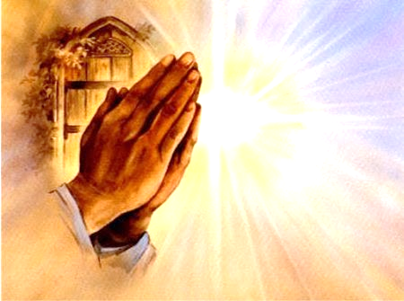
Pastoral Prayer
Lord’s Prayer
Notes:
Layout: Worship Title
All = Level 1
Use “indent” function (alt+shft+arrows) to change text style (level 1,2,3 etc).
Reset Slide will reset all styles to match the slide master.
To change Slide Background, Image, Text Box size etc, go to View – Slide Master View, and make changes there. Those changes will then be uniformly made throughout the Slideshow.

Slide 16
Our Father,
who art in heaven,
hallowed be Thy name.
Thy Kingdom come,
Thy will be done,
on earth, as it is in heaven.
Give us this day
our daily bread.
Forgive us our sins,
as we forgive those
who sin against us.
Lead us not into temptation,
but deliver us from evil.
For Thine is the Kingdom,
the Power, and the Glory forever. Amen
Notes:
Layout: Lord’s Prayer
Use “indent” function (alt+shft+arrows) to change text style (level 1,2,3 etc).
Text = Level 1 (adjust right here if you like, or on the Master Slide)
Reset Slide will reset all styles to match the slide master.
To change Slide Background, Image, Text Box size etc, go to View – Slide Master View, and make changes there. Those changes will then be uniformly made throughout the Slideshow.

Slide 17
Hear This Good News
Luke 21:5-19
New Revised Standard Version
New NNNNNNNNVersion
Notes:
Layout: Worship Title
Reading from: Level 2
Blank line: Level 3
Reference = Level 1
NRSV = level 3
Use “indent” function (alt+shft+arrows) to change text style (level 1,2,3 etc).
Reset Slide will reset all styles to match the slide master.
Change Text alignment to “Bottom” of the Text Box after resetting slide
To change Slide Background, Image, Text Box size etc, go to View – Slide Master View, and make changes there. Those changes will then be uniformly made throughout the Slideshow.

Slide 18
When some were speaking about the temple, how it was adorned with beautiful stones and gifts dedicated to God, he said, “As for these things that you see, the days will come when not one stone will be left upon another; all will be thrown down.”
Notes:
Layout: Worship Title
Reading from: Level 2
Blank line: Level 3
Reference = Level 1
NRSV = level 3
Use “indent” function (alt+shft+arrows) to change text style (level 1,2,3 etc).
Reset Slide will reset all styles to match the slide master.
Change Text alignment to “Bottom” of the Text Box after resetting slide
To change Slide Background, Image, Text Box size etc, go to View – Slide Master View, and make changes there. Those changes will then be uniformly made throughout the Slideshow.

Slide 19
They asked him, “Teacher, when will this be, and what will be the sign that this is about to take place?” And he said, “Beware that you are not led astray; for many will come in my name and say, ‘I am he!’ and, ‘The time is near!’ Do not go after them.
Notes:
Layout: Worship Title
Reading from: Level 2
Blank line: Level 3
Reference = Level 1
NRSV = level 3
Use “indent” function (alt+shft+arrows) to change text style (level 1,2,3 etc).
Reset Slide will reset all styles to match the slide master.
Change Text alignment to “Bottom” of the Text Box after resetting slide
To change Slide Background, Image, Text Box size etc, go to View – Slide Master View, and make changes there. Those changes will then be uniformly made throughout the Slideshow.

Slide 20
When you hear of wars and insurrections, do not be terrified; for these things must take place first, but the end will not follow immediately.” Then he said to them, “Nation will rise against nation, and kingdom against kingdom;
Notes:
Layout: Worship Title
Reading from: Level 2
Blank line: Level 3
Reference = Level 1
NRSV = level 3
Use “indent” function (alt+shft+arrows) to change text style (level 1,2,3 etc).
Reset Slide will reset all styles to match the slide master.
Change Text alignment to “Bottom” of the Text Box after resetting slide
To change Slide Background, Image, Text Box size etc, go to View – Slide Master View, and make changes there. Those changes will then be uniformly made throughout the Slideshow.

Slide 21
there will be great earthquakes, and in various places famines and plagues; and there will be dreadful portents and great signs from heaven. “But before all this occurs, they will arrest you and persecute you; they will hand you over to synagogues and prisons,
Notes:
Layout: Worship Title
Reading from: Level 2
Blank line: Level 3
Reference = Level 1
NRSV = level 3
Use “indent” function (alt+shft+arrows) to change text style (level 1,2,3 etc).
Reset Slide will reset all styles to match the slide master.
Change Text alignment to “Bottom” of the Text Box after resetting slide
To change Slide Background, Image, Text Box size etc, go to View – Slide Master View, and make changes there. Those changes will then be uniformly made throughout the Slideshow.

Slide 22
and you will be brought before kings and governors because of my name. This will give you an opportunity to testify. So make up your minds not to prepare your defense in advance; for I will give you words and a wisdom that none of your opponents will be able to withstand or contradict.
Notes:
Layout: Worship Title
Reading from: Level 2
Blank line: Level 3
Reference = Level 1
NRSV = level 3
Use “indent” function (alt+shft+arrows) to change text style (level 1,2,3 etc).
Reset Slide will reset all styles to match the slide master.
Change Text alignment to “Bottom” of the Text Box after resetting slide
To change Slide Background, Image, Text Box size etc, go to View – Slide Master View, and make changes there. Those changes will then be uniformly made throughout the Slideshow.

Slide 23
You will be betrayed even by parents and brothers, by relatives and friends; and they will put some of you to death. You will be hated by all because of my name.
Notes:
Layout: Worship Title
Reading from: Level 2
Blank line: Level 3
Reference = Level 1
NRSV = level 3
Use “indent” function (alt+shft+arrows) to change text style (level 1,2,3 etc).
Reset Slide will reset all styles to match the slide master.
Change Text alignment to “Bottom” of the Text Box after resetting slide
To change Slide Background, Image, Text Box size etc, go to View – Slide Master View, and make changes there. Those changes will then be uniformly made throughout the Slideshow.

Slide 24
But not a hair of your head will perish. By your endurance you will gain your souls.
Notes:
Layout: Worship Title
Reading from: Level 2
Blank line: Level 3
Reference = Level 1
NRSV = level 3
Use “indent” function (alt+shft+arrows) to change text style (level 1,2,3 etc).
Reset Slide will reset all styles to match the slide master.
Change Text alignment to “Bottom” of the Text Box after resetting slide
To change Slide Background, Image, Text Box size etc, go to View – Slide Master View, and make changes there. Those changes will then be uniformly made throughout the Slideshow.

Slide 25
This is the Word
of the Lord.
Thanks be to God.
Notes:
Text layout

Slide 26
Sermon
Pastor Bruce
Notes:
Layout: Worship Title
All = Level 1
Use “indent” function (alt+shft+arrows) to change text style (level 1,2,3 etc).
Reset Slide will reset all styles to match the slide master.
To change Slide Background, Image, Text Box size etc, go to View – Slide Master View, and make changes there. Those changes will then be uniformly made throughout the Slideshow.

Slide 28
Psalm 100 (Jubilate Deo)
Chancel Choir
Notes:
Layout: Worship Title
Title: Level 1
Blank Line: Level 3
Name: Level 2
Use “indent” function (alt+shft+arrows) to change text style (level 1,2,3 etc).
Reset Slide will reset all styles to match the slide master.
To change Slide Background, Image, Text Box size etc, go to View – Slide Master View, and make changes there. Those changes will then be uniformly made throughout the Slideshow.

Slide 29
Proclamation
Rev. William Brown
Notes:
Text layout

Slide 30
Come and Find
the Quiet Center
Chalice Hymnal 575

Slide 31
I Love to Tell the Story
Chalice Hymnal 480

Slide 32
I love to tell the story
of unseen things above,
Of Jesus and his glory,
of Jesus and his love.
1

Slide 33
I love to tell the story,
because I know ‘tis true;
It satisfies my longings
as nothing else can do.
1

Slide 34
I love to tell the story,
‘twill be my theme in glory,
To tell the old, old story
of Jesus and his love.
Refrain

Slide 35
I love to tell the story,
for those who know it best
Seem hungering and thirsting
to hear it like the rest.
3

Slide 36
And when, in scenes of glory,
I sing the new, new song,
‘Twill be the old, old story
that I have loved so long.
3

Slide 37
I love to tell the story,
‘twill be my theme in glory,
To tell the old, old story
of Jesus and his love.
Refrain

Slide 38
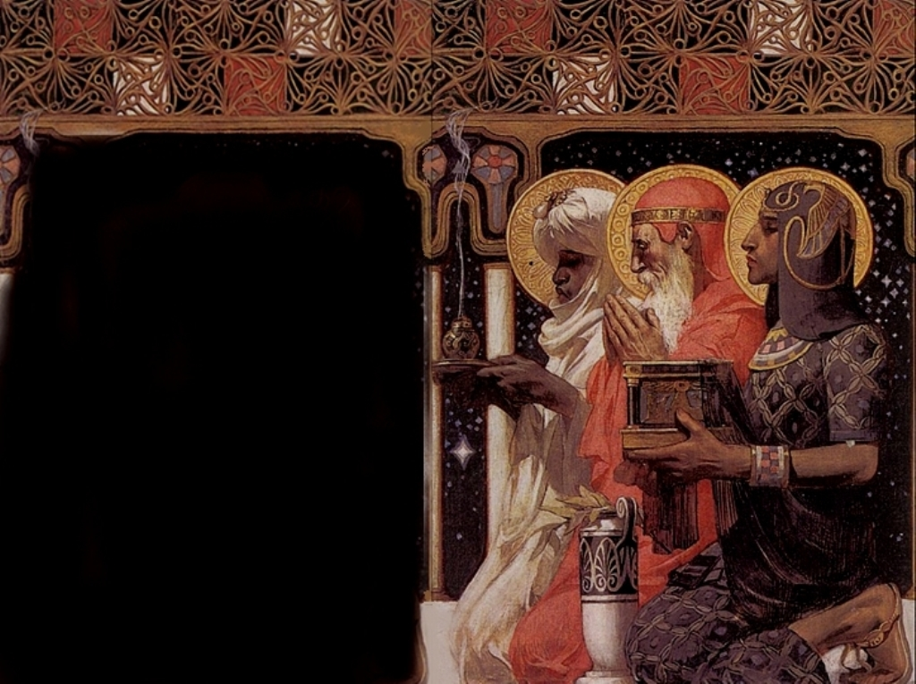
Invitation to Giving
Notes:
Layout: Worship Title
Title: Level 1
Blank Line: Level 3
Name: Level 2
Use “indent” function (alt+shft+arrows) to change text style (level 1,2,3 etc).
Reset Slide will reset all styles to match the slide master.
To change Slide Background, Image, Text Box size etc, go to View – Slide Master View, and make changes there. Those changes will then be uniformly made throughout the Slideshow.

Slide 39
Praise God from
whom all blessings flow;
Praise him,
all creatures
here below;
Praise him above,
ye heavenly host:
Praise Father, Son and Holy Ghost.
Notes:
Layout: Doxology
Title: Level 1
Text: Level 2
Empty line: level 3
Use “indent” function (alt+shft+arrows) to change text style (level 1,2,3 etc).
Reset Slide will reset all styles to match the slide master.
To change Slide Background, Image, Text Box size etc, go to View – Slide Master View, and make changes there. Those changes will then be uniformly made throughout the Slideshow.

Slide 40
Prayer of Dedication
Notes:
Layout: Communion
Use “indent” function (alt+shft+arrows) to change text style (level 1,2,3 etc).
Title = Level 1
Reset Slide will reset all styles to match the slide master.
To change Slide Background, Image, Text Box size etc, go to View – Slide Master View, and make changes there. Those changes will then be uniformly made throughout the Slideshow.

Slide 41
We Place Upon
Your Table, Lord
Chalice Hymnal 417
(alt. tune – GIFT OF LOVE)

Slide 42
We place upon
your table, Lord
The food of life,
the bread and wine,
As symbols of
our daily work,
According to
your grand design.
1

Slide 43
Within these simple
things there lie
The height and depth
of human life:
Our pain and tears,
our thoughts and toils,
Our hopes and fears,
our joy and strife.
2

Slide 44
Accept them, Lord
they come from you;
We take them humbly
from your hand.
These gifts of yours
for higher use
We offer up
as you command.
3

Slide 45
Invitation to Christ’s Table
Notes:
Layout: Communion
Use “indent” function (alt+shft+arrows) to change text style (level 1,2,3 etc).
Title = Level 1
Reset Slide will reset all styles to match the slide master.
To change Slide Background, Image, Text Box size etc, go to View – Slide Master View, and make changes there. Those changes will then be uniformly made throughout the Slideshow.

Slide 46
Sharing the Peace of Christ
May the peace of Christ be with you
And also with you.

Slide 47
Prayer for the Bread and Cup
Notes:
Layout: Communion
Use “indent” function (alt+shft+arrows) to change text style (level 1,2,3 etc).
Title = Level 1
Reset Slide will reset all styles to match the slide master.
To change Slide Background, Image, Text Box size etc, go to View – Slide Master View, and make changes there. Those changes will then be uniformly made throughout the Slideshow.

Slide 48
Breathe on Me, Breath of God - Wilbur Held
Notes:
Layout: Worship Title
Title: Level 1
Blank Line: Level 3
Name: Level 2
Use “indent” function (alt+shft+arrows) to change text style (level 1,2,3 etc).
Reset Slide will reset all styles to match the slide master.
To change Slide Background, Image, Text Box size etc, go to View – Slide Master View, and make changes there. Those changes will then be uniformly made throughout the Slideshow.

Slide 49
All Are Welcome
Notes:
Layout: Communion
Use “indent” function (alt+shft+arrows) to change text style (level 1,2,3 etc).
Title = Level 1
Reset Slide will reset all styles to match the slide master.
To change Slide Background, Image, Text Box size etc, go to View – Slide Master View, and make changes there. Those changes will then be uniformly made throughout the Slideshow.

Slide 50
Go in Peace
Chalice Hymnal 445

Slide 51
Go in peace,
and the peace of God
be with you this day.
Go in peace
and the peace of God
be with you always.
1

Slide 52
Celebrate and
share the joy!
Celebrate new life!
Go in peace
and the peace of God
be with you always.
2

Slide 53
Benediction
Notes:
Layout: Worship Title
All = Level 1
Use “indent” function (alt+shft+arrows) to change text style (level 1,2,3 etc).
Reset Slide will reset all styles to match the slide master.
To change Slide Background, Image, Text Box size etc, go to View – Slide Master View, and make changes there. Those changes will then be uniformly made throughout the Slideshow.

Slide 54
Restoration Promise - Robert J. Powell
May the
Light of Christ surround you.
May you bring
Christ’s love in
all places.
Notes:
Layout: Worship Title
Carrying: Level 2
Blank lines: level 3
May the Light, May you bring…: Level 1
Use “indent” function (alt+shft+arrows) to change text style (level 1,2,3 etc).
Reset Slide will reset all styles to match the slide master.
To change Slide Background, Image, Text Box size etc, go to View – Slide Master View, and make changes there. Those changes will then be uniformly made throughout the Slideshow.
TITLE SPECIAL LAYOUT (like slide 8)
to change layout of the slide, right click in the left column, select Layout from the list, and select the layout you want.

